Slide 1


SOCIAL MEDIA POLICE
Real-time AI & Misinformation Detection for Facebook

Slide 2



The Landscape: Trust in Crisis
Social media feeds are facing an unprecedented crisis of authenticity, driven by three converging factors:
The AI Flood: Generative AI creates synthetic "slop" engagement bait that mimics human sentiment perfectly.
The Misinformation Gap: Fact-checking typically occurs hours after a post has gone viral, too late to stop the spread.
Walled Gardens: Platforms like Facebook restrict API access, preventing traditional server-side analysis tools from working.

Slide 3

The Solution
Social Media Police (SMP) is a Chrome Extension that integrates directly into your Facebook feed. It acts as a digital guardian, analyzing posts and comments in real-time to detect AI-generated content and potential misinformation. Using advanced Large Language Models and heuristic analysis, SMP provides an instant trust score for the content you consume and aggregate the results into a local DB.

Slide 4






Key Features
Seamless Integration
Real-time Analysis
Context Aware
Injects an "Analyze" button directly into the Facebook action bar, sitting naturally next to Like, Comment, and Share.
Utilizes MutationObserver to automatically detect and process new posts instantly as you scroll through your feed.
Intelligently scrapes the original post context when analyzing comments to ensure high accuracy and relevance.

Slide 5


The AI Engine
Heuristic Score (50%)
Model Intuition (50%)
A fast, code-based analysis that scans for rigid patterns often found in machine-generated text.
Leverages advanced Large Language Models to assess the nuanced human quality of the text.
It checks for:
It evaluates:
•
Specific "AI" vocabulary
•
Tone and emotional resonance
•
Unnatural structural patterns
•
Logical flow and reasoning
•
Perfect grammar anomalies
•
Burstiness (sentence variety)

Slide 6
Detection Heuristics
Punctuation Overuse of em-dashes (—) and "perfect" grammar lacking typical human errors.
Vocabulary Frequent use of "AI Words" like delve, tapestry, leverage, transformative, crucial.
Structure The "Sandwich" structure (Intro -> Bullets -> Summary) and low burstiness (uniform sentence length).
Tone & Consistency Overly generic, corporate "voice" lacking personal anecdotes, and unrealistic uniformity across posts.

Slide 7






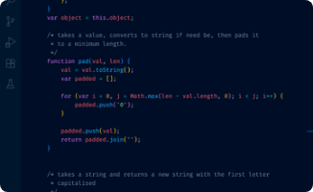


Tech Stack
Platform
Languages
AI Providers
Chrome Extension (Manifest V3)
JavaScript (ES6+) HTML5, CSS3
OpenAI, Claude, Gemini, or any OpenRouter supported model

Slide 8
Installation Guide
2. Open
4. Load
Go to chrome://extensions
Load unpacked extension
1. Clone
3. Enable
5. Configure
Clone the repository
Turn on Developer Mode
Pin & Add API Keys

Slide 9
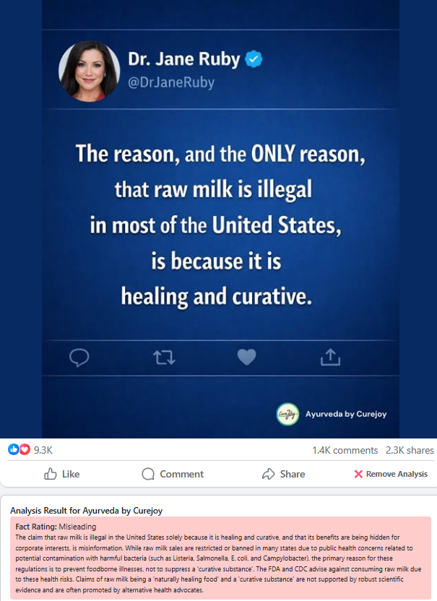
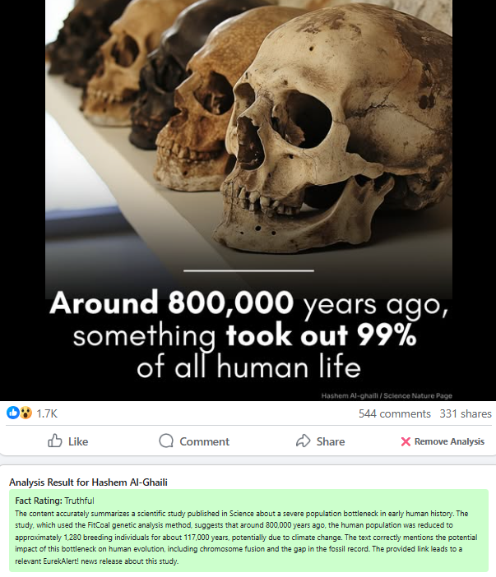
Case Examples – Post Facts

Slide 10
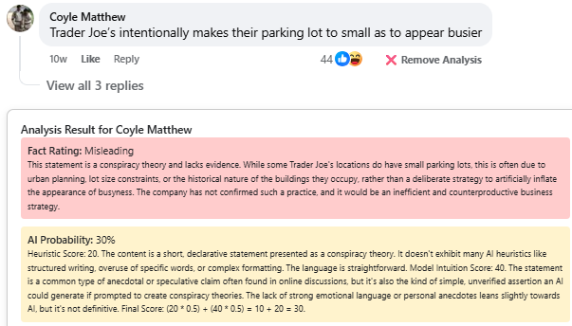
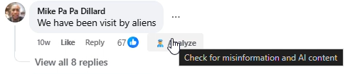
Case Examples – User Comments

Slide 11
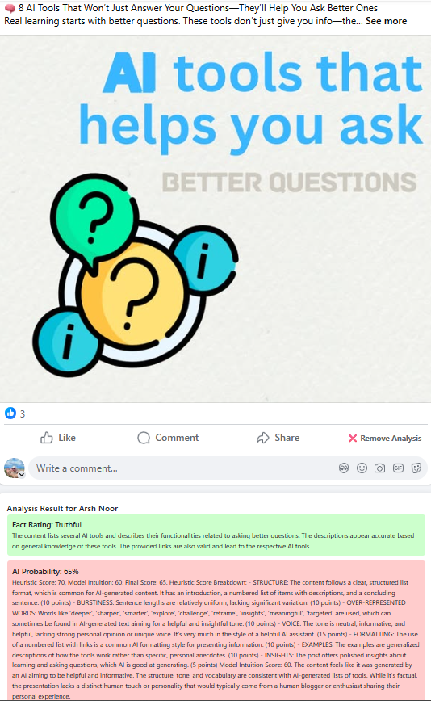
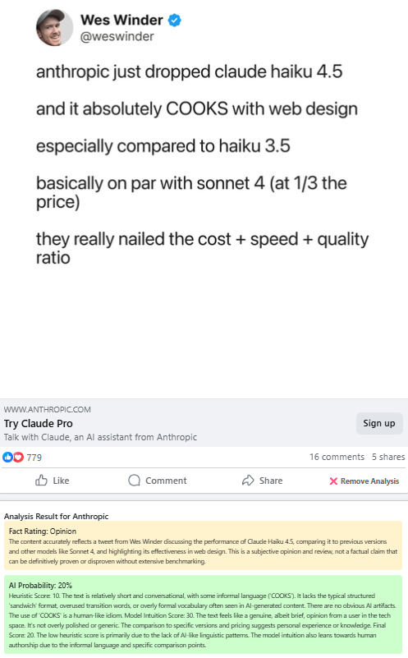
Case Examples – AI Slope

Slide 12
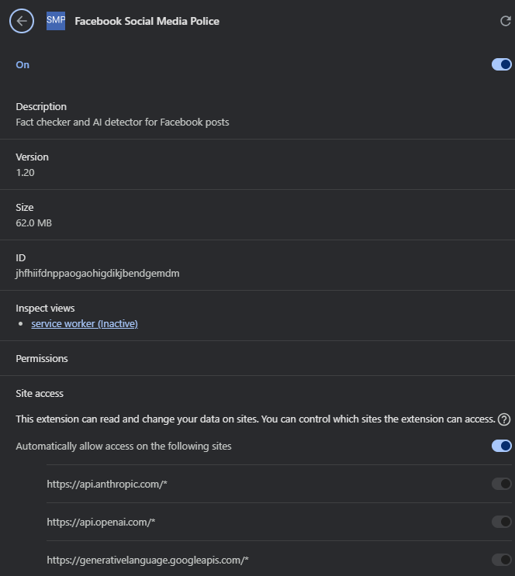
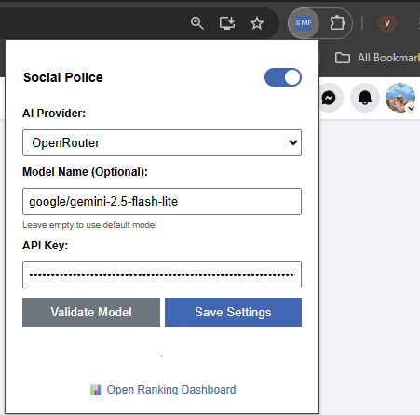
Examples – Configurations

Slide 13
Questions?
Thank you for your time. Social Media Police Vitaly Chait https://github.com/VitalyChait/SMP

